Slide 1
Artificial Intelligence
Enrique Peláez Ph.D.

Slide 2
Agenda
Techniques for solving AI problems

Slide 3
Techniques for solving AI problems
Some applications:
MARVEL: Real time expert system in Voyager to help diagnose failures in the probe.
NAVLAB: Autonomous vehicle that travels in the US, from coast to coast.
DEEP BLUE: A chess-playing computer developed by IBM that defeated world champion Garry Kasparov in 1997.
PEGASUS: An automated phone reservation machine for air transportation.
Expert System for diagnosing diseases with the capacity to explain the reasons of the diagnosis.
Vision System to monitor the traffic in Paris for detecting car accidents and directly calls the police or emergency response teams.

Slide 4
Techniques for solving AI problems
Norton antivirus uses neural nets for detecting virus infections in computers:
  http://www.symantec.com/press/1999/n990804a.html
Autonomous Land Vehicle In a Neural Network (ALVINN)
  http://www.ri.cmu.edu/projects/project_160.html
Computer Vision for business
  http://www.mvtec.com/
Virtual Mascots modeled using neural nets.
  http://www.seattleweekly.com/diversions/0447/041124_gg1_pettoys.php
Player behaviour modelled using neural nets in computer games.
  http://aigamedev.com/tutorials/

Slide 5
Example: TIC-TAC-TOE
There could be the following 3 different solutions for the tic-tac-toe problem:

Slide 6
Example: TIC-TAC-TOE
There could be the following 3 different solutions for the tic-tac-toe problem:
Solution 1:
  A simple solution to this game could be to store in a vector the 19.693 possibilities of the 3 x 3 board, with the three possible values for each cell (empty-X-O), and the corresponding next move.
  To play a move, it will be enough to access the position of the current state of the board and determine the next move.
  It has some disadvantages:

Slide 7
Example: TIC-TAC-TOE
There could be the following 3 different solutions for the tic-tac-toe problem:
Solution 1:
  A simple solution to this game could be to store in a vector the 19.693 possibilities of the 3 x 3 board, with the three possible values for each cell (empty-X-O), and the corresponding next move.
  To play a move, it will be enough to access the position of the current state of the board and determine the next move.
  It has some disadvantages:
    The solution needs enough memory; somebody has to write and store all moves and possible next moves; and, the game can not be extended, for example, to a 3 dimensional game.

Slide 8
Example: TIC-TAC-TOE
Solution 2:

Slide 9
Example: TIC-TAC-TOE
Solution 2:
  The program has stored the strategy for each turn of the players.
  Evaluates all possible solutions based on the current state of the board.
  Although, it is less efficient than the previous solution, in terms of time, it is more efficient in terms of space.
  The strategy of representing the game is better for understanding the game; hence, it facilitates any possible change, but the programmer has to understand the whole strategy beforehand.
  Also, it not possible to generalize the strategy to a different domain; such as, 3D tic-tac-toe.

Slide 10
Example: TIC-TAC-TOE
Solution 3:

Slide 11
Example: TIC-TAC-TOE
Solution 3:
Create a structure with the current state of the board, as well as the list of the board positions for the next move, and an estimate of the probability to win the game.
To decide the next move the system keeps the state of the board and the next potential moves.
Based on the best move, the system makes a decision, it considers if the move is a winner; otherwise, it considers all movements that the opponent can make to win, which is the worse scenario for the player.
The algorithm looks for several sequences of movements, trying to maximize the wining probability.
It needs much more time than the other 2, because it has to search a tree with all the possibilities before each move. However, it is a lot better than the other solutions because it can be extended to other more sophisticated games.
Also, it can have an intelligent behavior using the knowledge about the game; for example, instead of considering all possible moves, takes into account a subset only, following some reasonable criteria.
And this is an example of a technique used in AI.

Slide 12
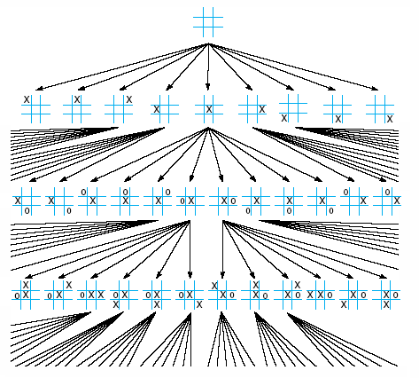
Example: TIC-TAC-TOE

Slide 13
Techniques for solving AI problems
This example exposes 3 important characteristics of the techniques used in AI:

Slide 14
Techniques for solving AI problems
This example exposes 3 important characteristics of the techniques used in AI:
  Search: It provides a mechanism for solving a problem where there is not a direct method.
  Use of knowledge: It provides a mechanism for solving complex problems using the exiting structures and information of the involved objects.
  Abstraction: It provides a mechanism to concentrate on those aspects that are important for the solution of the problem, and separate those that are not important and could make the process collapse.

Slide 15
Techniques for solving AI problems
One of the results, from early research in AI, showed that intelligent behaviour needs knowledge.
Knowledge has some undesirable properties, such as:
  It is bulky
  Difficult to characterized
  It changes
  It is commonly organized in the same way as it will be used.

Slide 16
Techniques for solving AI problems
The techniques to solve problems in AI are methods that use the knowledge represented, such that:
  It represents generalizations; that is, it is not necessary to represent each particular situation, but those situations that share common important properties can be grouped together.
  It has to be understood by the knowledge providers.
  It can be modified to reflect the changes of the real world.
  It can be used in different situations, even though it could be incomplete or vague.
  It can be used to overcome its own inaccuracies, and reduce the range of possibilities to be considered.

Slide 17
Techniques for solving AI problems
The AI techniques can be categorized with independence of the problem to be solve.
For complex problems, the AI techniques represent several advantages:
  The solutions are less fragile; that is, the systems do not frozen or halt when the input is uncommon.
  The knowledge of the system is easily comprehended by the users.
  It uses generalizations.
  It can be easily expanded and extended to other problem domains.

Slide 18
Techniques for solving AI problems
AI techniques in general, incorporate search processes.
Search methods can be considered as searching trees, in which each node represents a state of the problem and each link represents the relationship between the linked states.
In general, there are rules that determine how to navigate the tree, and parts of the tree can be generated or expanded as the rules fire.

Slide 19
Techniques for solving AI problems
There are directions associated with the links, which direct the search (forward or backward search).
There is also a control strategy for selecting the rules that can be applied. Good control strategies always allow to move to other states and advance systematically in the search process.

Slide 20
Problem resolution in AI
State search
Initial State
operator
Final State

Slide 21
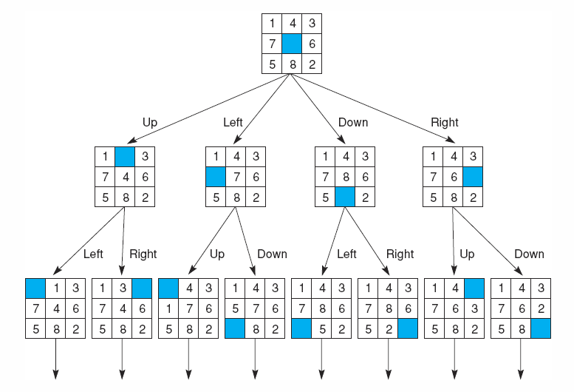
Techniques for solving AI problems

Slide 22
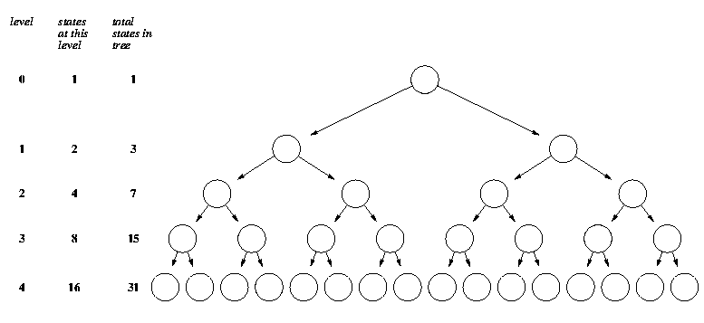
Techniques for solving AI problems
level
State at this level
Total # of states

Slide 23
Techniques for solving AI problems
  Some times the search process can involve searching in a graph instead of a tree, which can be of benefit if we explore routes that are essentially the same. However, there are some associated requisites:
    Each time a new node is generated it needs to be checked if it has been created in pass.
    It needs special procedures to avoid to get trapped in a loop during the search.

Slide 24
Techniques for solving AI problems
Commonly, to solve a problem, we need:

Slide 25
Techniques for solving AI problems
Commonly, to solve a problem, we need:
  Formally define the problem.

Slide 26
Techniques for solving AI problems
Commonly, to solve a problem, we need:
  Formally define the problem.
  Analyze the problem.

Slide 27
Techniques for solving AI problems
Commonly, to solve a problem, we need:
  Formally define the problem.
  Analyze the problem.
  Represent the necessary knowledge to solve the problem.

Slide 28
Techniques for solving AI problems
Commonly, to solve a problem, it we need:
  Formally define the problem.
  Analyze the problem.
  Represent the necessary knowledge to solve the problem.
  Select the best technique to solve the problem and implement it.

